Slide 1
From zero to hero

Slide 2
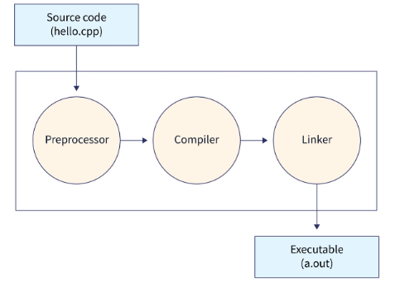
C++ is a compiled language. That means that to get a program to run, you must first translate it from the human-readable form to something a machine can “understand.” That translation is done by a program called a compiler.

Slide 3
it is important to know how to compile C++ program codes and how to execute them. When we write code, we write it in a high-level language that machines can't understand, known as source code. The code that machines can understand & execute is in binary form (0's and 1's) and is known as machine code, object code, or executable code.
Translating source code (high-level language code) into machine-readable code consists of the following four processes that we will learn in detail as we move through the course of this article:
Pre-processing the source code
Compiling the source code
Assembling the compiled file
Linking the object code file to create an executable file

Slide 4
What is C++?
C++ is a cross-platform language that can be used to create high-performance applications.
C++ was developed by Bjarne Stroustrup, as an extension to the C language.
C++ gives programmers a high level of control over system resources and memory.
The language was updated 4 major times in 2011, 2014, 2017, and 2020 to C++11, C++14, C++17, C++20.

Slide 5
Difference between C and C++
C++ was developed as an extension of C, and both languages have almost the same syntax.
The main difference between C and C++ is that C++ support classes and objects, while C does not.

Slide 6
To start using C++, you need two things:
A text editor, like Notepad, to write C++ code
A compiler, like GCC, to translate the C++ code into a language that the computer will understand

Slide 7
C++ Install IDE
An IDE (Integrated Development Environment) is used to edit AND compile the code.
Popular IDE's include Code::Blocks, Eclipse, and Visual Studio. These are all free, and they can be used to both edit and debug C++ code.
Note: Web-based IDE's can work as well, but functionality is limited.
Download the mingw-setup.exe file, which will install the text editor with a compiler.

Slide 8
create our first C++ file.
Open Codeblocks and go to File > New > Empty File.
Write the following C++ code and save the file as myfirstprogram.cpp (File > Save File as):

Slide 9
#include <iostream> using namespace std; int main()
{ cout << "Hello World!"; return 0; }
Line 1: #include <iostream> is a header file library that lets us work with input and output objects, such as cout (used in line 5). Header files add functionality to C++ programs
Line 2: using namespace std means that we can use names for objects and variables from the standard library.

Slide 10
Line 3: A blank line. C++ ignores white space. But we use it to make the code more readable.
Line 4: Another thing that always appear in a C++ program, is int main(). This is called a function. Any code inside its curly brackets {} will be executed.
Line 5: cout (pronounced "see-out") is an object used together with the insertion operator (<<) to output/print text. In our example it will output "Hello World!".
Note: Every C++ statement ends with a semicolon ;.
Note: The body of int main() could also been written as: int main () { cout << "Hello World! "; return 0; }
Remember: The compiler ignores white spaces. However, multiple lines makes the code more readable.
Line 6: return 0 ends the main function.
Line 7: Do not forget to add the closing curly bracket } to actually end the main function

Slide 11
Omitting Namespace
You might see some C++ programs that runs without the standard namespace library. The using namespace std line can be omitted and replaced with the std keyword, followed by the :: operator for some objects:
#include <iostream> int main() { std::cout << "Hello World!"; return 0; }
Note: It is up to you if you want to include the standard namespace library or not.

Slide 13
C++ Output
The cout object, together with the << operator, is used to output values/print text:
You can add as many cout objects as you want. However, note that it does not insert a new line at the end of the output:
#include <iostream> using namespace std; int main() { cout << "Hello World!"; cout << "I am dancing"; return 0; }
Note: The symbol << is called insertion operation and output operator.
The insertion operator << is the one we usually use for output, as in:
cout << "This is output" << end;
It gets its name from the idea of inserting data into the output stream.
>> Operator called extraction operator. The extraction operator (>>), which is preprogrammed for all standard C++ data types, is the easiest way to get bytes from an input stream object.
Formatted text input extraction operators depend on white space to separate incoming data values.

Slide 14
New Lines
To insert a new line, you can use the \n character:
#include <iostream> using namespace std; int main() { cout << "Hello World! \n"; cout << "I am learning C++"; return 0; }
Two \n characters after each other will create a blank line:

Slide 15
Another way to insert a new line, is with the endl manipulator:
#include <iostream> using namespace std; int main() { cout << "Hello World!" << endl; cout << "I am learning C++"; return 0; }

Slide 16
Both \n and endl are used to break lines. However, \n is most used.
But what is \n exactly?
The newline character (\n) is called an escape sequence,
and it forces the cursor to change its position to the beginning of the next line on the screen. This results in a new line.

Slide 17
Escape sequence | Character represented
\a | Alert (bell, alarm)
\b | Backspace
\f | Form feed (new page)
\n | New-line
\r | Carriage return
\t | Horizontal tab
\v | Vertical tab
\' | Single quotation mark
\" | Double quotation mark
\? | Question mark
\\ | Backslash

Slide 18
C++ Comments
Comments can be used to explain C++ code, and to make it more readable. It can also be used to prevent execution when testing alternative code. Comments can be singled-lined or multi-lined.
Single-line comments start with two forward slashes (//).
// This is a comment cout << "Hello World!";
---------------------
/* The code below will print the words Hello World! to the screen, and it is amazing */ cout << "Hello World!";

Slide 19
C++ Variables
imagine that I ask you to remember the number 5, and then I ask you to also memorize the number 2 at the same time.
You have just stored two different values in your memory (5 and 2).
Now, if I ask you to add 1 to the first number I said, you should be retaining the numbers 6 (that is 5+1) and 2 in your memory.
Then we could, for example, subtract these values and obtain 4 as result.
The whole process described above is a simile of what a computer can do with two variables. The same process can be expressed in C++ with the following set of statements:
a = 5; b = 2; a = a + 1; result = a - b;

Slide 20

We can now define variable as a portion of memory to store a value.
Each variable needs a name that identifies it and distinguishes it from the others.
For example, in the previous code the variable names were a, b, and result, but we could have called the variables any names we could have come up with, as long as they were valid C++ identifiers.

Slide 21
C++ Variables
Variables are containers for storing data values.
In C++, there are different types of variables (defined with different keywords), for example:
int - stores integers (whole numbers), without decimals, such as 123 or -123
double - stores floating point numbers, with decimals, such as 19.99 or -19.99
char - stores single characters, such as 'a' or 'B'. Char values are surrounded by single quotes
string - stores text, such as "Hello World". String values are surrounded by double quotes
bool - stores values with two states: true or false

Slide 22
Declaring (Creating) Variables
Syntax
type variableName = value;
Example
int myNum = 15; cout << myNum; or
int myNum; myNum = 15; cout << myNum;

Slide 23
Note that if you assign a new value to an existing variable, it will overwrite the previous value:
int myNum = 15; // myNum is 15 myNum = 10; // Now myNum is 10 cout << myNum; // Outputs 10
int myNum = 5; // Integer (whole number without decimals) double myFloatNum = 5.99; // Floating point number (with decimals) char myLetter = 'D'; // Character string myText = "Hello"; // String (text) bool myBoolean = true; // Boolean (true or false)

Slide 24
Basic Data Types
Data Type | Size | Description
boolean | 1 byte | Stores true or false values
char | 1 byte | Stores a single character/letter/number, or ASCII values
int | 2 or 4 bytes | Stores whole numbers, without decimals
float | 4 bytes | Stores fractional numbers, containing one or more decimals. Sufficient for storing 6-7 decimal digits
double | 8 bytes | Stores fractional numbers, containing one or more decimals. Sufficient for storing 15 decimal digits

Slide 25
e.g.s
int myNum = 1000; cout << myNum;
---------------------------------------
float myNum = 5.75; cout << myNum;
--------------------
double myNum = 19.99; cout << myNum;
------------------------
Note:
float vs. double
The precision of a floating point value indicates how many digits the value can have after the decimal point. The precision of float is only six or seven decimal digits, while double variables have a precision of about 15 digits. Therefore it is safer to use double for most calculations.

Slide 26
Scientific Numbers
A floating point number can also be a scientific number with an "e" to indicate the power of 10:
float f1 = 35e3; double d1 = 12E4; cout << f1; cout << d1;

Slide 27
C++ Boolean Data Types
A boolean data type is declared with the bool keyword and can only take the values true or false.
When the value is returned, true = 1 and false = 0.
bool isMeSmart = true; bool isMeFool = false;
cout << isMeSmart; // Outputs 1 (true) cout << isMeFool; // Outputs 0 (false)
Boolean values are mostly used for conditional testing

Slide 28
C++ Character Data Types
The char data type is used to store a single character.
The character must be surrounded by single quotes, like 'A' or 'c’:
char myGrade = 'B'; cout << myGrade;

Slide 29
C++ String Data Types
The string type is used to store a sequence of characters (text).
`This is not a built-in type, but it behaves like one in its most basic usage.
String values must be surrounded by double quotes:
string greeting = "Hello"; cout << greeting;
To use strings,
you must include an additional header file in the source code,
the <string> library:
// Include the string library #include <string> // Create a string variable string greeting = "Hello"; // Output string value cout << greeting;

Slide 30
int myAge = 35; cout << "I am " << myAge << " years old.";
int x = 5; int y = 6; int sum = x + y; cout << sum;

Slide 31
Create a variable named gg and assign the value 3567to it.

Slide 32
C++ Declare Multiple Variables
To declare more than one variable of the same type, use a comma-separated list
int x = 5, y = 6, z = 50; cout << x + y + z;
One Value to Multiple Variables
int x, y, z; x = y = z = 50; cout << x + y + z;

Slide 33
Identifiers
All C++ variables must be identified with unique names.
These unique names are called identifiers.
A valid identifier is a sequence of one or more letters, digits, or underscore characters (_).
Spaces, punctuation marks, and symbols cannot be part of an identifier. In addition, identifiers shall always begin with a letter.
They can also begin with an underline character (_), but such identifiers are -on most cases- considered reserved for compiler-specific keywords or external identifiers, as well as identifiers containing two successive underscore characters anywhere.
In no case can they begin with a digit.
C++ uses a number of keywords to identify operations and data descriptions; therefore, identifiers created by a programmer cannot match these keywords.
The standard reserved keywords that cannot be used for programmer created identifiers are:

Slide 34
alignas, alignof, and, and_eq, asm, auto, bitand, bitor, bool, break, case, catch, char, char16_t, char32_t, class, compl, const, constexpr, const_cast, continue, decltype, default, delete, do, double, dynamic_cast, else, enum, explicit, export, extern, false, float, for, friend, goto, if, inline, int, long, mutable, namespace, new, noexcept, not, not_eq, nullptr, operator, or, or_eq, private, protected, public, register, reinterpret_cast, return, short, signed, sizeof, static, static_assert, static_cast, struct, switch, template, this, thread_local, throw, true, try, typedef, typeid, typename, union, unsigned, using, virtual, void, volatile, wchar_t, while, xor, xor_eq
Specific compilers may also have additional specific reserved keywords. Very important: The C++ language is a "case sensitive" language
. That means that an identifier written in capital letters is not equivalent to another one with the same name but written in small letters. T
hus, for example, the RESULT variable is not the same as the result variable or the Result variable. These are three different identifiers identifiying three different variables.

Slide 35
The general rules for naming variables are:or variable naming convension
The general rules for naming variables are:
Names can contain letters, digits and underscores
Names must begin with a letter or an underscore (_)
Names are case sensitive (myVar and myvar are different variables)
Names cannot contain whitespaces or special characters like !, #, %, etc.
Reserved words (like C++ keywords, such as int) cannot be used as names

Slide 36
C++ Constants use the const keyword (this will declare the variable as "constant", which means unchangeable and read-only):
const int myNum = 15; // myNum will always be 15 myNum = 10; // error: assignment of read-only variable 'myNum'

Slide 37
Important note
When you declare a constant variable, it must be assigned with a value:
Literals
Literals are the most obvious kind of constants. They are used to express particular values within the source code of a program.
These literal constants have a type, just like variables. By default, integer literals are of type
int. However, certain suffixes may be appended to an integer literal to specify a different integer type: Unsigned may be combined with any of the other two in any order to form unsigned long or unsigned long long.
Suffix | Type modifier
u or U | unsigned
l or L | long
ll or LL | long long

Slide 38
Preprocessor definitions (#define)
Another mechanism to name constant values is the use of preprocessor definitions.
They have the following form: #define identifier replacement After this directive, any occurrence of identifier in the code is interpreted as replacement,
where replacement is any sequence of characters (until the end of the line).
This replacement is performed by the preprocessor, and
happens before the program is compiled,
thus causing a sort of blind replacement:
the validity of the types or syntax involved is not checked in any way.

Slide 39
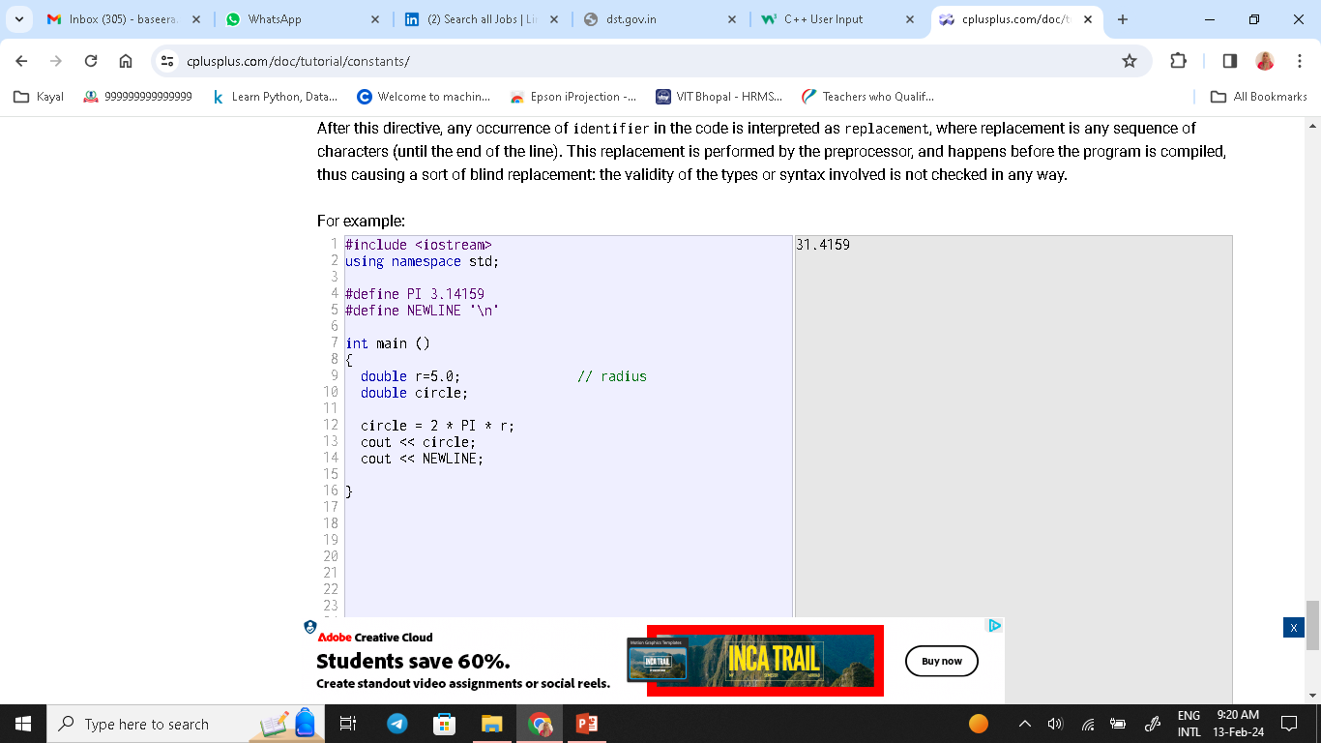

Slide 40
What is your observation in preprocessor definitons ?

Slide 41
Ans is …
Note that
the #define lines are preprocessor directives,
and as such are single-line instructions that -unlike C++ statements-
do not require semicolons (;) at the end;
the directive extends automatically until the end of the line
. If a semicolon is included in the line,
it is part of the replacement sequence and
is also included in all replaced occurrences.

Slide 42
Operators
Assignment operator (=)
The assignment operator assigns a value to a variable.
x = 5;
This statement assigns the integer value 5 to the variable x. The assignment operation always takes place from right to left, and never the other way around:
x = y
This statement assigns to variable x the value contained in variable y

Slide 43
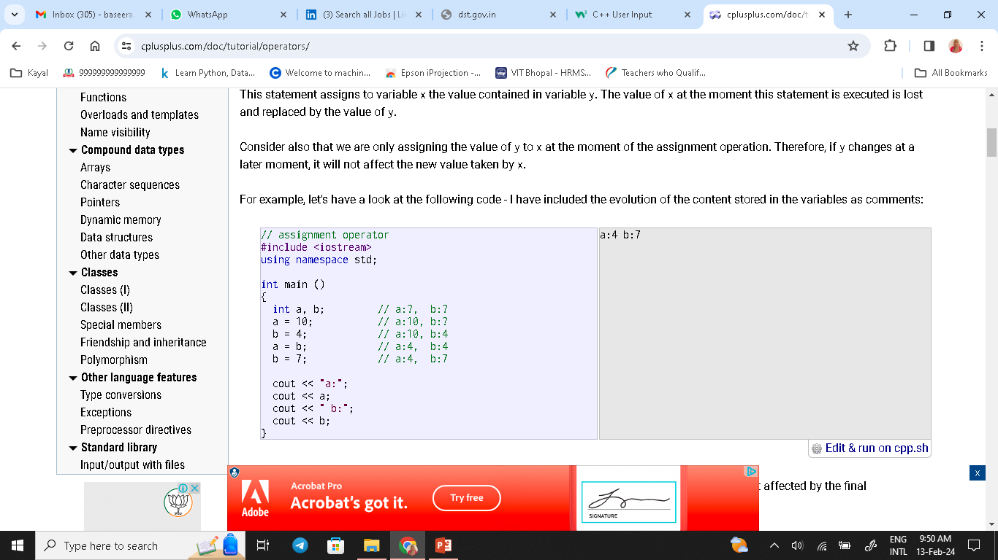

Slide 44
y = 2 + (x = 5);
Or
x = 5; y = 2 + x;
x = y = z = 5; is this valid ?
It assigns 5 to the all three variables: x, y and z; always from right-to-left.

Slide 45
Arithmetic operators ( +, -, *, /, % )
operator | description
+ | addition
- | subtraction
* | multiplication
/ | division
% | modulo

Slide 46
Operations of addition, subtraction, multiplication and division
correspond literally to their respective mathematical operators.
The last one, modulo operator, represented by a percentage sign
(%), gives the remainder of a division of two values. For example:
x = 11 % 3; results in variable x containing the value 2, since dividing 11 by 3 results in 3, with a remainder of 2.

Slide 47
Compound assignment (+=, -=, *=, /=, %=, >>=, <<=, &=, ^=, |=)
xpression | equivalent to...
y += x; | y = y + x;
x -= 5; | x = x - 5;
x /= y; | x = x / y;
price *= units + 1; | price = price * (units+1);

Slide 48
1 2 3 4 5 6 7 8 9 10 11 | // compound assignment operators #include <iostream> using namespace std; int main () { int a, b=3; a = b; a+=2; // equivalent to a=a+2 cout << a; Return 0; }

Slide 49
Increment and decrement (++, --) some expression can be shortened even more: the increase operator (++) and the decrease operator (--) increase or reduce by one the value stored in a variable. They are equivalent to +=1 and to -=1, respectively. Thus:
1 2 3 | ++x; x+=1; x=x+1;

Slide 50
Relational and comparison operators ( ==, !=, >, <, >=, <= )
operator | description
== | Equal to
!= | Not equal to
< | Less than
> | Greater than
<= | Less than or equal to
>= | Greater than or equal to
(7 == 5) // evaluates to false (5 > 4) // evaluates to true (3 != 2) // evaluates to true (6 >= 6) // evaluates to true (5 < 5) // evaluates to false

Slide 51
Logical operators ( !, &&, || )
operator ! is the C++ operator for the Boolean operation NOT
The operator && corresponds to the Boolean logical operation AND
The operator || corresponds to the Boolean logical operation OR,
,
.

Slide 52
Conditional ternary operator ( ? :)
The conditional operator evaluates an expression, returning one value if that expression evaluates to true, and a different one if the expression evaluates as false. Its syntax is: condition ? result1 : result2
If(a>b)?a is big :b is big

Slide 53
Comma operator ( , ) The comma operator (,) is used to separate two or more expressions that are included where only one expression is expected. When the set of expressions has to be evaluated for a value, only the right-most expression is considered.
1 | a = (b=3, b+2);

Slide 54
Bitwise operators ( &, |, ^, ~, <<, >> )
operator | asm equivalent | description
& | AND | Bitwise AND
| | OR | Bitwise inclusive OR
^ | XOR | Bitwise exclusive OR
~ | NOT | Unary complement (bit inversion)
<< | SHL | Shift bits left
>> | SHR | Shift bits right

Slide 55
Explicit type casting operator
Type casting operators allow to convert a value of a given type to another type. There are several ways to do this in C++. The simplest one, which has been inherited from the C language, is to precede the expression to be converted by the new type enclosed between parentheses (()):
int i; float f = 3.14; i = (int) f;
i = int (f);

Slide 56
sizeof
This operator accepts one parameter, which can be either a type or a variable, and returns the size in bytes of that type or object: x = sizeof (char)

Slide 57
Basic Input/Output
1 2 | cout << "First sentence." << endl; cout << "Second sentence." << endl;
int age; cin >> age;

Slide 58
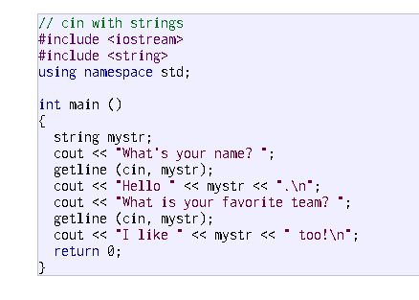

Slide 59
Statements and flow control
Selection statements:
if (condition) statement
If you want to include more than a single statement to be executed when the condition is fulfilled, these statements shall be enclosed in braces ({}), forming a block:
if (x == 100) cout << "x is 100";
if (x == 100) { cout << "x is "; cout << x; }

Slide 60
Selection statements with if can also specify what happens when the condition is not fulfilled, by using the else keyword to introduce an alternative statement. Its syntax is:
if (condition) statement1 else statement2
where statement1 is executed in case condition is true, and in case it is not, statement2 is executed.

Slide 61
if (x == 100) cout << "x is 100"; else cout << "x is not 100";

Slide 62
Several if + else structures can be concatenated with the intention of checking a range of values
if (x > 0) cout << "x is positive"; else if (x < 0) cout << "x is negative"; else cout << "x is 0";

Slide 63
Iteration statements (loops)
Loops repeat a statement a certain number of times, or
while a condition is fulfilled
. They are introduced by the keywords while, do, and for. The while loop
The simplest kind of loop is the while-loop. Its syntax is: while (expression) statement The while-loop simply repeats statement while expression is true.
If, after any execution of statement, expression is no longer true, the loop ends
, and
the program continues right after the loop.
For example, let's have a look at a countdown using a while-loop:

Slide 64
while (condition) { // code block to be executed }
int i = 0;
while (i < 5) {
cout << i << "\n";
i++;
}

Slide 65
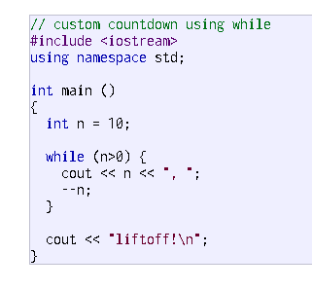

Slide 66
The do-while loop
Do
statement
……..
…..
while (condition);
It behaves like a while-loop,
except that condition is evaluated after the execution of statement instead of before,
guaranteeing at least one execution of statement, even if condition is never fulfilled.
For example, the following example program echoes any text the user introduces until the user enters goodbye:

Slide 67
do { // code block to be executed } while (condition);
int i = 0;
do {
cout << i << "\n";
i++;
}
while (i < 5);

Slide 69
The for loop
Its syntax is: for (initialization; condition; increase) statement;

Slide 70
Continued…
Like the while-loop, this loop repeats statement while condition is true.
But, in addition, the for loop provides specific locations to contain an initialization and
an increase expression, executed before the loop begins the first time, and
after each iteration, respectively.
Therefore, it is especially useful to use counter variables as condition. It works in the following way:
initialization is executed. Generally, this declares a counter variable, and sets it to some initial value.
This is executed a single time, at the beginning of the loop.
condition is checked. If it is true, the loop continues; otherwise, the loop ends, and
statement is skipped, going directly to step 5.
statement is executed. As usual, it can be either a single statement or a block enclosed in curly braces { }.
increase is executed, and the loop gets back to step 2.
the loop ends: execution continues by the next statement after it.

Slide 71
eg
 | // countdown using a for loop #include <iostream> using namespace std; int main () { for (int n=10; n>0; n--) { cout << n << ", "; } cout << "liftoff!\n"; return 0; }

Slide 72
The break statement
break leaves a loop, even if the condition for its end is not fulfilled.
It can be used to end an infinite loop, or to force it to end before its natural end
. For example, let's stop the countdown before its natural end:
// break loop example
#include <iostream>
using namespace std;
int main ()
{
for (int n=10; n>0; n--)
{
cout << n << ", ";
if (n==3)
{
cout << "countdown aborted!";
break;
} } }

Slide 73
The continue statement
The continue statement causes the program to skip the rest of the loop in the current iteration, as if the end of the statement block had been reached, causing it to jump to the start of the following iteration. For example, let's skip number 5 in our countdown:
// continue loop example
#include <iostream>
using namespace std;
int main ()
{
for (int n=10; n>0; n--) {
if (n==5) continue;
cout << n << ", ";
}
cout << "liftoff!\n";
}

Slide 74
The goto statement
goto allows to make an absolute jump to another point in the program. This unconditional jump ignores nesting levels, and does not cause any automatic stack unwinding. Therefore, it is a feature to use with care, and preferably within the same block of statements, especially in the presence of local variables.
The destination point is identified by a label, which is then used as an argument for the goto statement. A label is made of a valid identifier followed by a colon (:).
goto is generally deemed a low-level feature, with no particular use cases in modern higher-level programming paradigms generally used with C++. But, just as an example, here is a version of our countdown loop using goto:

Slide 75
eg
// goto loop example
#include <iostream>
using namespace std;
int main ()
{
int n=10;
mylabel:
cout << n << ", ";
n--;
if (n>0) goto mylabel;
cout << "liftoff!\n";
}

Slide 76
Another selection statement: switch.
The syntax of the switch statement is a bit peculiar. Its purpose is to check for a value among a number of possible constant expressions. It is something similar to concatenating if-else statements, but limited to constant expressions. Its most typical syntax is:
code>switch (expression)
{
case constant1:
group-of-statements-1;
break;
case constant2:
group-of-statements-2;
break;
default:
default-group-of-statements
}/code>

Slide 77
This is how it works:
The switch expression is evaluated once
The value of the expression is compared with the values of each case
If there is a match, the associated block of code is executed
The break and default keywords are optional, and will be described later in this chapter

Slide 78
int day = 4;
switch (day) {
case 1:
cout << "Monday";
break;
case 2:
cout << "Tuesday";
break;
case 3:
cout << "Wednesday";
break;
case 4:
cout << "Thursday";
break;
case 5:
cout << "Friday";
break;
case 6:
cout << "Saturday";
break;
case 7:
cout << "Sunday";
break;
}
// Outputs "Thursday" (day 4)

Slide 79
The default Keyword The default keyword specifies some code to run if there is no case match:
int day = 4;
switch (day) {
case 6:
cout << "Today is Saturday";
break;
case 7:
cout << "Today is Sunday";
break;
default:
cout << "Looking forward to the Weekend";
}

Slide 80
Arrays
An array is a series of elements of the same type placed in contiguous memory locations that can be individually referenced by adding an index to a unique identifier.
Arrays are used to store multiple values in a single variable, instead of declaring separate variables for each value.
To declare an array, define the variable type, specify the name of the array followed by square brackets and specify the number of elements it should store:

Slide 81
string cars[4];
string cars[4] = {"Volvo", "BMW", "Ford", "Mazda"};
int myNum[3] = {10, 20, 30};
Access the Elements of an Array
string cars[4] = {"Volvo", "BMW", "Ford", "Mazda"};
cout << cars[0];
// Outputs Volvo

Slide 82
Functions
A function is a block of code which only runs when it is called.
You can pass data, known as parameters, into a function.
Functions are used to perform certain actions, and they are important for reusing code: Define the code once, and use it many times.
void myFunction() {
// code to be executed
}

Slide 83
// Create a function
void myFunction() {
cout << "I just got executed!";
}
int main() {
myFunction(); // call the function
return 0;
}
// Outputs "I just got executed!"

Slide 84
A function can be called multiple times:
void myFunction() { cout << "I just got executed!\n"; } int main() { myFunction(); myFunction(); myFunction(); return 0; } // I just got executed! // I just got executed! // I just got executed!

Slide 85
Function Declaration and Definition
A C++ function consist of two parts:
Declaration: the return type, the name of the function, and parameters (if any)
Definition: the body of the function (code to be executed)
void myFunction() { // declaration // the body of the function (definition) }

Slide 86
int main() { myFunction(); return 0; } void myFunction() { cout << "I just got executed!"; }

Slide 87
However, it is possible to separate the declaration and the definition of the function - for code optimization.
You will often see C++ programs that have function declaration above main(), and function definition below main(). This will make the code better organized and easier to read:

Slide 88
// Function declaration
void myFunction();
// The main method
int main() {
myFunction(); // call the function
return 0;
}
// Function definition
void myFunction() {
cout << "I just got executed!";
}

Slide 89
C++ Function Parameters
Parameters and Arguments
Information can be passed to functions as a parameter. Parameters act as variables inside the function.
Parameters are specified after the function name, inside the parentheses. You can add as many parameters as you want, just separate them with a comma:

Slide 90
Syntax
void functionName(parameter1, parameter2, parameter3) {
// code to be executed
}
The following example has a function that takes a string called fname as parameter. When the function is called, we pass along a first name, which is used inside the function to print the full name:
void myFunction(string fname) {
cout << fname << " Refsnes\n";
}
int main() {
myFunction(“anju");
myFunction(“manju");
myFunction("Anu");
return 0;
}

Slide 91
The Return Keyword / call by value
Return Values
The void keyword, used in the previous examples, indicates that the function should not return a value. If you want the function to return a value, you can use a data type (such as int, string, etc.) instead of void, and use the return keyword inside the function:
`int myFunction(int x) {
return 5 + x;
}
int main() {
cout << myFunction(3);
return 0;
}

Slide 93
Functions - Pass By Reference
Pass By Reference
void swapNums(int &x, int &y) {
int z = x;
x = y;
y = z;
}
int main() {
int firstNum = 10;
int secondNum = 20;
cout << "Before swap: " << "\n";
cout << firstNum << secondNum << "\n";
// Call the function, which will change the values of firstNum and secondNum
swapNums(firstNum, secondNum);
cout << "After swap: " << "\n";
cout << firstNum << secondNum << "\n";
return 0;
}

Slide 94
Function Overloading With function overloading, multiple functions can have the same name with different parameters:
int myFunction(int x)
float myFunction(float x)
double myFunction(double x, double y)
Example
int plusFuncInt(int x, int y) {
return x + y;
}
double plusFuncDouble(double x, double y) {
return x + y;
}
int main() {
int myNum1 = plusFuncInt(8, 5);
double myNum2 = plusFuncDouble(4.3, 6.26);
cout << "Int: " << myNum1 << "\n";
cout << "Double: " << myNum2;
return 0;
}

Slide 95
OOP
OOP stands for Object-Oriented Programming.
Procedural programming is about writing procedures or functions that perform operations on the data, while object-oriented programming is about creating objects that contain both data and functions.
Object-oriented programming has several advantages over procedural programming:
OOP is faster and easier to execute
OOP provides a clear structure for the programs
OOP helps to keep the C++ code DRY "Don't Repeat Yourself", and makes the code easier to maintain, modify and debug
OOP makes it possible to create full reusable applications with less code and shorter development time

Slide 96
C++ What are Classes and Objects?
Classes and objects are the two main aspects of object-oriented programming.
Look at the following illustration to see the difference between class and objects:

Slide 97
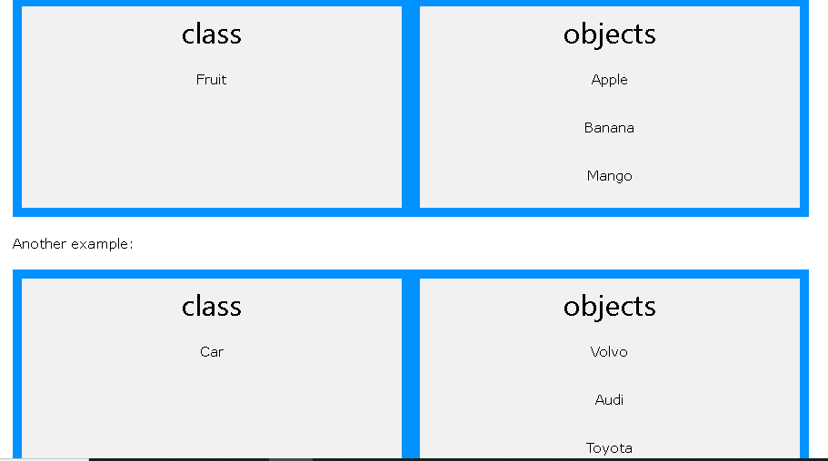

Slide 98
Classes/Objects
Everything in C++ is associated with classes and objects, along with its attributes and methods. For example: in real life, a car is an object. The car has attributes, such as weight and color, and methods, such as drive and brake.
Attributes and methods are basically variables and functions that belongs to the class. These are often referred to as "class members".
A class is a user-defined data type that we can use in our program, and it works as an object constructor, or a "blueprint" for creating objects.

Slide 99
Create a Class To create a class, use the class keyword:
class MyClass { // The class
public: // Access specifier
int regno; // Attribute (int variable)
string name; // Attribute (string variable)
};
The class keyword is used to create a class called MyClass.
The public keyword is an access specifier, which specifies that members (attributes and methods) of the class are accessible from outside the class. You will learn more about access specifiers later.
Inside the class, there is an integer variable myNum and a string variable myString. When variables are declared within a class, they are called attributes.
At last, end the class definition with a semicolon ;.

Slide 100
Create an Object
To create an object of MyClass, specify the class name, followed by the object name.
To access the class attributes (myNum and myString), use the dot syntax (.) on the object:
class MyClass { // The class
public: // Access specifier
int myNum; // Attribute (int variable)
string myString; // Attribute (string variable)
};
int main() {
MyClass myObj; // Create an object of MyClass
// Access attributes and set values
myObj.myNum = 15;
myObj.myString = "Some text";
// Print attribute values
cout << myObj.myNum << "\n";
cout << myObj.myString;
return 0;
}

Slide 101
Multiple Objects you can create multiple objects of one class:
// Create a Car class with some attributes
class Car {
public:
string brand;
string model;
int year; };
int main() {
// Create an object of Car
Car carObj1;
carObj1.brand = "BMW";
carObj1.model = "X5";
carObj1.year = 1999;
// Create another object of Car
Car carObj2;
carObj2.brand = "Ford";
carObj2.model = "Mustang";
carObj2.year = 1969;
// Print attribute values
cout << carObj1.brand << " " << carObj1.model << " " << carObj1.year << "\n";
cout << carObj2.brand << " " << carObj2.model << " " << carObj2.year << "\n";
return 0;
}

Slide 102
Class Methods
Methods are functions that belongs to the class.
There are two ways to define functions that belongs to a class:
Inside class definition
Outside class definition
In the following example, we define a function inside the class, and we name it "myMethod".
Note: You access methods just like you access attributes; by creating an object of the class and using the dot syntax (.):

Slide 103
class MyClass { // The class
public: // Access specifier
void myMethod() { // Method/function defined inside the class
cout << "Hello World!";
}
};
int main() {
MyClass myObj; // Create an object of MyClass
myObj.myMethod(); // Call the method
return 0;
}

Slide 104
Usage of :: or
To define a function outside the class definition, you have to declare it inside the class and then define it outside of the class.
This is done by specifiying the name of the class, followed the scope resolution :: operator, followed by the name of the function:

Slide 105
eg
class MyClass { // The class
public: // Access specifier
void myMethod(); // Method/function declaration
};
// Method/function definition outside the class
void MyClass::myMethod() {
cout << "Hello World!";
}
int main() {
MyClass myObj; // Create an object of MyClass
myObj.myMethod(); // Call the method
return 0;
}

Slide 106
Parameters You can also add parameters:
#include <iostream> using namespace std; class Car { public: int speed(int maxSpeed); }; int Car::speed(int maxSpeed) { return maxSpeed; } int main() { Car myObj; // Create an object of Car cout << myObj.speed(200); // Call the method with an argument return 0; }

Slide 107
Difference between Structure and Class in C++
In C++, the structure is the same as the class with some differences. Security is the most important thing for both structure and class. A structure is not safe because it could not hide its implementation details from the end-user, whereas a class is secure as it may hide its programming and design details

Slide 108
A structure is a grouping of variables of various data types referenced by the same name. A structure declaration serves as a template for creating an instance of the structure.
Syntax:
Struct Structurename
{
Struct_member1;
Struct_member2;
Struct_member3;
.
.
.
Struct_memberN;
};

Slide 109
A class in C++ is similar to a C structure in that it consists of a list of data members and a set of operations performed on the class. In other words, a class is the building block of Object-Oriented programming. It is a user-defined object type with its own set of data members and member functions that can be accessed and used by creating a class instance. A C++ class is similar to an object's blueprint.
Syntax:
class class_name
{
// private data members and member functions.
Access specifier;
Data member;
Member functions (member list){ . . }
};

Slide 110
Main differences between the structure and class
By default, all the members of the structure are public. In contrast, all members of the class are private.
The structure will automatically initialize its members. In contrast, constructors and destructors are used to initialize the class members.
When a structure is implemented, memory allocates on a stack. In contrast, memory is allocated on the heap in class.
Variables in a structure cannot be initialized during the declaration, but they can be done in a class.
There can be no null values in any structure member. On the other hand, the class variables may have null values.
A structure is a value type, while a class is a reference type.
Operators to work on the new data form can be described using a special method.

Slide 111
Features | Structure | Class
Definition | A structure is a grouping of variables of various data types referenced by the same name. | In C++, a class is defined as a collection of related variables and functions contained within a single structure.
Basic | If no access specifier is specified, all members are set to 'public'. | If no access specifier is defined, all members are set to 'private'.
Declaration | struct structure_name{ type struct_member 1; type struct_member 2; type struct_member 3; . type struct_memberN; }; | class class_name{ data member; member function; };
Instance | Structure instance is called the 'structure variable'. | A class instance is called 'object'.
Inheritance | It does not support inheritance. | It supports inheritance.
Memory Allocated | Memory is allocated on the stack. | Memory is allocated on the heap.
Nature | Value Type | Reference Type
Purpose | Grouping of data | Data abstraction and further inheritance.
Usage | It is used for smaller amounts of data. | It is used for a huge amount of data.
Null values | Not possible | It may have null values.
Requires constructor and destructor | It may have only parameterized constructor. | It may have all the types of constructors and destructors.

Slide 112
Similarities
The following are similarities between the structure and class:
Both class and structure may declare any of their members private.
Both class and structure support inheritance mechanisms.
Both class and structure are syntactically identical in C++.
A class's or structure's name may be used as a stand-alone type.

Slide 113
container class…
A container class is a data type that is capable of holding a collection of items. In C++, container classes can be implemented as a class, along with member functions to add, remove, and examine items.
As an example, I have two classes A and B. An object of B is a member of class A (container). What is the best way to access data of container class (A) from the member class (object of B). Also, I don't want to use inheritance (B -> A) as B is not logically derived from A.

Slide 114
class first {
public:
void showf()
{ cout << "Hello from first class\n";
} };
// Container class
class second {
// creating object of first
first f;
public:
// constructor
second() {
// calling function of first class
f.showf();
} };
int main() {
// creating object of second
second s; }

Slide 116
Constructors
A constructor in C++ is a special method that is automatically called when an object of a class is created.
To create a constructor, use the same name as the class, followed by parentheses ():

Slide 117
eg
class MyClass { // The class
public: // Access specifier
MyClass() { // Constructor
cout << "Hello World!";
}
};
int main() {
MyClass myObj; // Create an object of MyClass (this will call the constructor)
return 0;
}

Slide 118
Constructor Parameters or parameterized constructor
Constructors can also take parameters (just like regular functions), which can be useful for setting initial values for attributes.
class Car { // The class
public: // Access specifier
string brand; // Attribute
string model; // Attribute
int year; // Attribute
Car(string x, string y, int z) { // Constructor with parameters
brand = x;
model = y;
year = z;
}
};
int main() {
// Create Car objects and call the constructor with different values
Car carObj1("BMW", "X5", 1999);
Car carObj2("Ford", "Mustang", 1969);
// Print values
cout << carObj1.brand << " " << carObj1.model << " " << carObj1.year << "\n";
cout << carObj2.brand << " " << carObj2.model << " " << carObj2.year << "\n";
return 0;
}

Slide 119
Just like functions, constructors can also be defined outside the class. First, declare the constructor inside the class, and then define it outside of the class by specifying the name of the class, followed by the scope resolution ::
class Car { // The class
public: // Access specifier
string brand; // Attribute
string model; // Attribute
int year; // Attribute
Car(string x, string y, int z); // Constructor declaration
};
// Constructor definition outside the class
Car::Car(string x, string y, int z) {
brand = x;
model = y;
year = z;
}
int main() {
// Create Car objects and call the constructor with different values
Car carObj1("BMW", "X5", 1999);
Car carObj2("Ford", "Mustang", 1969);
// Print values
cout << carObj1.brand << " " << carObj1.model << " " << carObj1.year << "\n";
cout << carObj2.brand << " " << carObj2.model << " " << carObj2.year << "\n";
return 0;
}

Slide 120
class Car { // The class
public: // Access specifier
string brand; // Attribute
string model; // Attribute
int year; // Attribute
Car(string x, string y, int z); // Constructor declaration
};
// Constructor definition outside the class
Car::Car(string x, string y, int z) {
brand = x;
model = y;
year = z;
}
int main() {
// Create Car objects and call the constructor with different values
Car carObj1("BMW", "X5", 1999);
Car carObj2("Ford", "Mustang", 1969);
// Print values
cout << carObj1.brand << " " << carObj1.model << " " << carObj1.year << "\n";
cout << carObj2.brand << " " << carObj2.model << " " << carObj2.year << "\n";
return 0;
}

Slide 121
Access Specifiers
Already discussed …….

Slide 122
In C++, there are three access specifiers:
public - members are accessible from outside the class
private - members cannot be accessed (or viewed) from outside the class
protected - members cannot be accessed from outside the class, however, they can be accessed in inherited classes.

Slide 123
Example
class MyClass {
public: // Public access specifier
int x; // Public attribute
private: // Private access specifier
int y; // Private attribute
};
int main() {
MyClass myObj;
myObj.x = 25; // Allowed (public)
myObj.y = 50; // Not allowed (private)
return 0;
}
Execute this and tell me the result

Slide 124
If you try to access a private member, an error occurs:
error: y is private
Note: It is possible to access private members of a class using a public method inside the same class. See the next chapter (Encapsulation) on how to do this.
Tip: It is considered good practice to declare your class attributes as private (as often as you can). This will reduce the possibility of yourself (or others) to mess up the code. This is also the main ingredient of the Encapsulation concept, which you will learn more about in the next chapter.
Note: By default, all members of a class are private if you don't specify an access specifier:

Slide 125
Encapsulation
The meaning of Encapsulation, is to make sure that "sensitive" data is hidden from users. To achieve this, you must declare class variables/attributes as private (cannot be accessed from outside the class). If you want others to read or modify the value of a private member, you can provide public get and set methods.
Access Private Members
To access a private attribute, use public "get" and "set" methods:
#include <iostream> using namespace std; class Employee { private: // Private attribute int salary; public: // Setter void setSalary(int s) { salary = s; } // Getter int getSalary() { return salary; } }; int main() { Employee myObj; myObj.setSalary(50000); cout << myObj.getSalary(); return 0; } same prg in next slide

Slide 126
#include <iostream> using namespace std; class Employee { private: // Private attribute int salary; public: // Setter void setSalary(int s) { salary = s; } // Getter int getSalary() { return salary; } }; int main() { Employee myObj; myObj.setSalary(50000); cout << myObj.getSalary(); return 0; }

Slide 127
Encapsulation?
It is considered good practice to declare your class attributes as private (as often as you can). Encapsulation ensures better control of your data, because you (or others) can change one part of the code without affecting other parts
Increased security of data

Slide 128
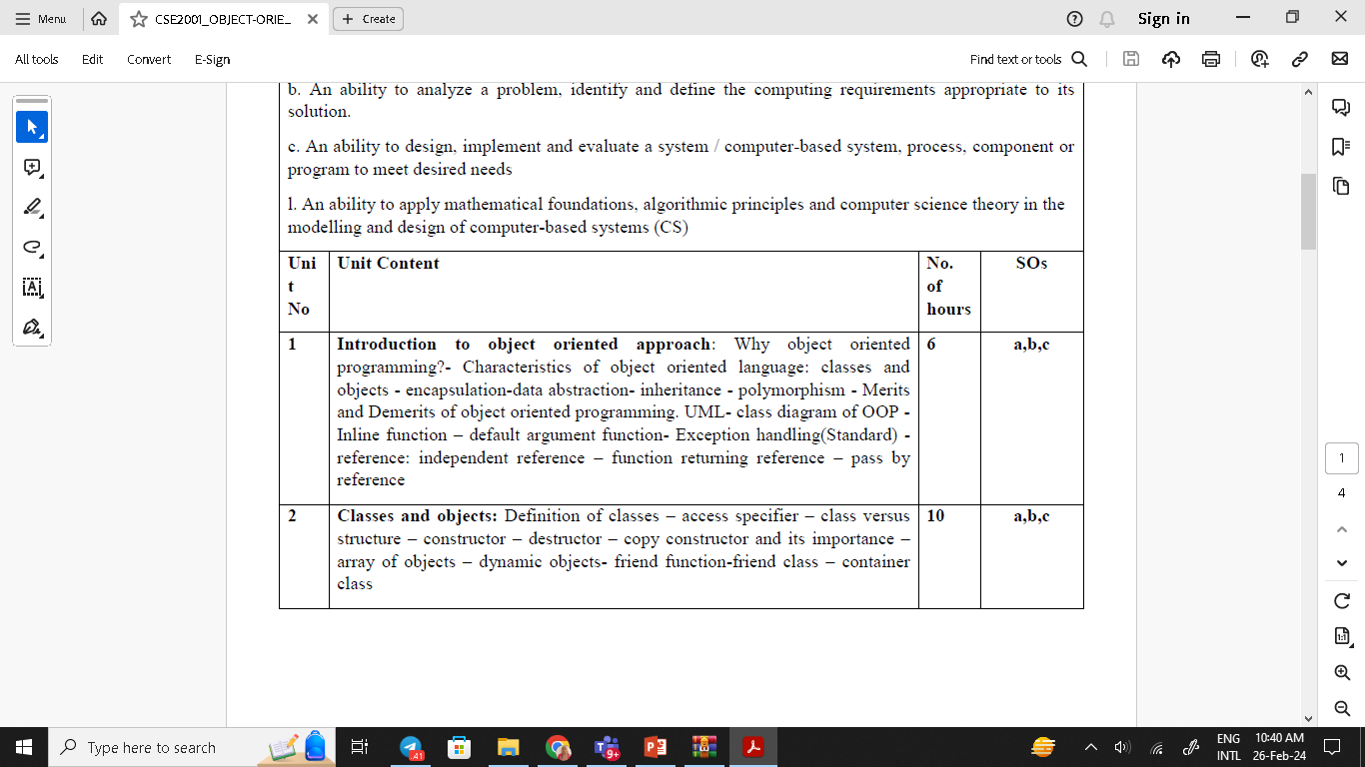
Syllabus

Slide 129
Inheritance
The mechanism of deriving a new class from an existing class is called inheritance.
The existing class is referred as base class and the new one is called derived class.
The derived class inherits all capabilities of base class & also add new features to this class. But the base class remains unchanged
this feature supports code reusability.
Once a class has been written and tested , it can be used by other programmers to suit their requirements.
In C++, it is possible to inherit attributes and methods from one class to another. We group the "inheritance concept" into two categories:
derived class (child) - the class that inherits from another class
base class (parent) - the class being inherited from
To inherit from a class, use the : symbol.

Slide 130
Defining Derived Classes :
class derived-class name : visibility mode base-
class name
{
members of derived class
};

Slide 131
eg. for single inheritance :
#include<iostream.h>
#include<conio.h>
class emp
{
int no;
char name[10];
public:
void get( )
{
cout<< "\n\nenter no & name \n";
cin>>no;
cin >>name;
}
void print( )
{
cout<<"\n\nname is "<< name;
cout<<"\nno is " << no;
}
};

Slide 132
class physic : public emp
{
float height,weight;
public:
void read( )
{ get( ) ;
cin >> height >> weight; }
void disp()
{
print();
cout<<height;
cout<<weight;}
};

Slide 133
Continued……
void main( )
{
physic p;
clrscr();
p.read();
p.disp();
getch();
}

Slide 134
Visibility Modes
While deriving the new classes , the visibility modes gives the total control over the data members & methods of the base class. The visibility mode may be private , public or protected.

Slide 135
Ambiguity Resolution In Inheritance
The ambiguity error arises whenever a data member and member function are defined with a same name in both the base & derived classes. The compiler cannot distinguish between the member functions of the two classes. To resolve this problem scope resolution operator is used.

Slide 136
EG
#include <iostream.h>
class bas
{
int no;
public:
void get()
{ cin >> no;}
void put()
{ cout << no;}
} ;

Slide 137
Cont..
class der : public bas
{
char name[10];
public :
void get()
{ cin >> name;}
void put()
{ cout<<"\n name = "<<name ; } };

Slide 138
Cont..
void main()
{ der d;
d.bas::get();
d.get();
d.bas::put();
d.put();
}

Slide 139
https://cplusplus.com/doc/tutorial/variables/
https://www.javatpoint.com/cpp-variable

